Slide 1
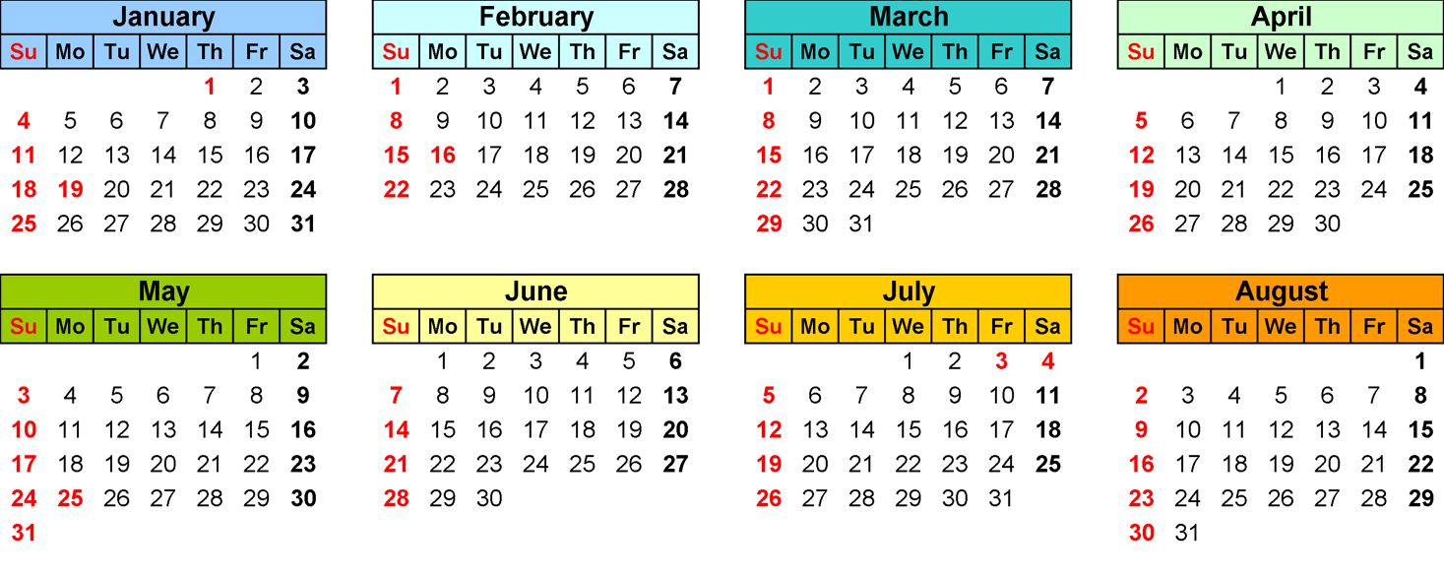
Static Polity
Economy
Theory: Geography, History, Environment, Science
Qatal ki Subah
~200 days
Earlier failures:
Far away=>from scratch
Closer=>mocks+GSM+Optional+Backup exams

Slide 2
CSAT-2015
Paper-II
Lectures=>Practice=>Diary of errors=>Mock tests
How to prepare for Paper II: Mrunal.org/Aptitude

Slide 3
Newspaper & Magazines
Hindu, IndianExpress (Rajamohan, Economy)
Frontline, EPW
Yojana, Kurukshetra
Competitive Magazines

Slide 4
The Hindu: Essential for MAINS
Why?
Ignore
Statements lifted
Questions inspired
RC passages
Economy, Polity
Science Tech, Environment
Industry, Market
City, states, southern region
Sports pages (PIN)
Metro/lifestyle (Book review)

Slide 5
How to get Hindu?
Library
Postal subscription
Online Archive: http://www.thehindu.com/archive/web/2015/01/
feedly

Slide 6
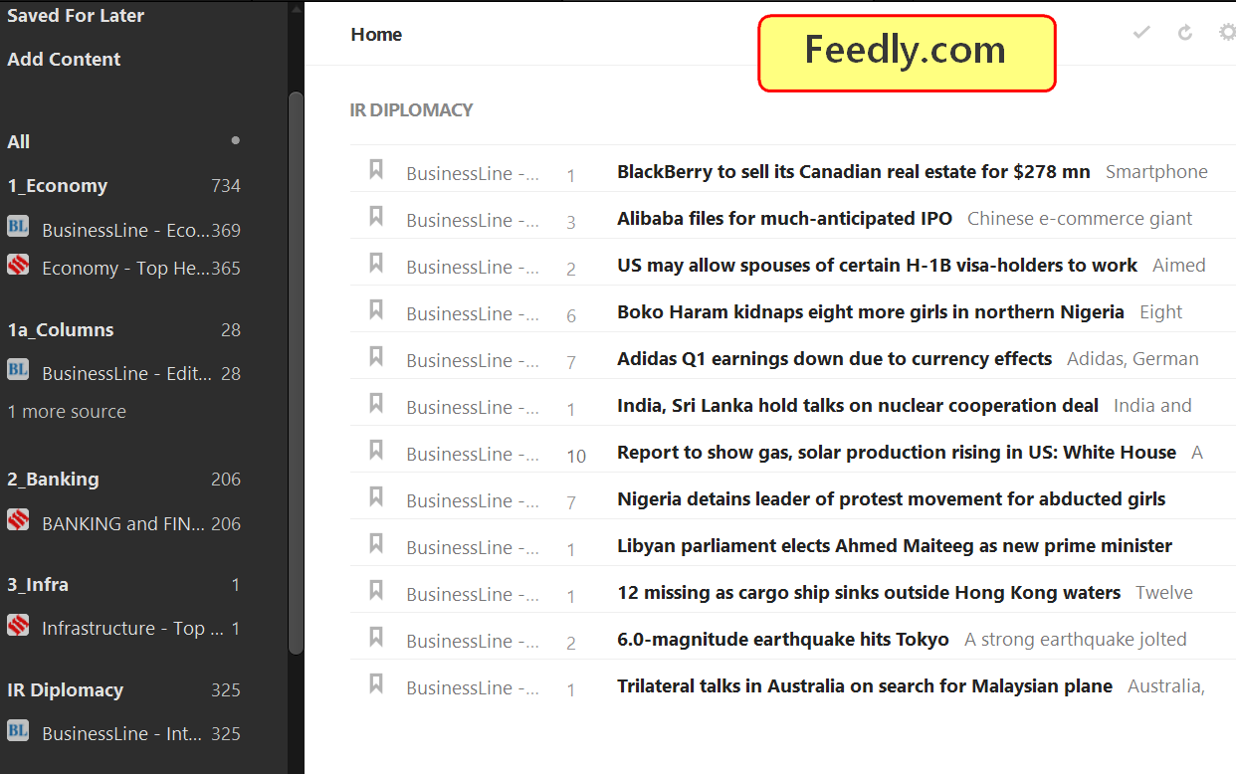
Feedly.com
Notes:
Blogs cut paste bullet

Slide 7
MINIMUM
National
International
Economy
Editorial
Comments / letters to editor

Slide 8
How to use Hindu?
Only Prelims
P+M
OLF (One Line fodder)
Ignore
Understand it here: http://mrunal.org/2015/01/current-affairs-topiclist-january-2014-html.html

Slide 9
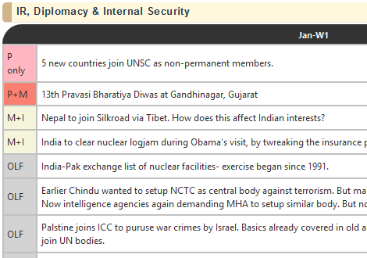

Slide 10
Magazines
Frontline (MUST)
EPW (not must)
offline => online article download
Book review
History, Culture
Polity, IR, environment
Socio-economic essays
bookreview

Slide 11
MAGAZINES
Yojana | Kurukshetra
Science reporter
Competitive magazines:
CST | wizard | chronicle (LIBRARY)
Pratiyogita Darpan (sports, PIN, Q.Papers)
If time permits: Loksabha TV debates | AIR News | DD News
Bottom-line: don’t burn your slum for topper’s palace.

Slide 12
Notes Making
Why?: Lengthy Mains-papers. Speed vs elegance.
Essay and Vague question- bol-bachchan-giri requires practice.

Slide 13

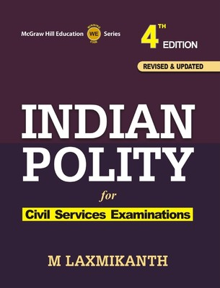
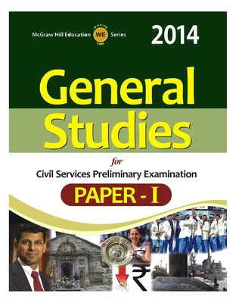
Notes not required, HIGHLIGHTER

Slide 14

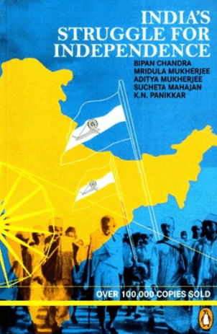

Margin Notes

Slide 15
Full length notes
Where?
How?
Optional Subject
Current Affairs
Maths: Diary of mistakes
Paper notes
Electronic notes

Slide 16


Paper notes: A4 papers & folders
Bookmarks
L-folder

Slide 17

A4 papers & folders (Obama)
Report files
Indexing
Continuous Writing Practice

Slide 18
Electronic Notes
MS Office: Onenote
Evernote | Google Keep
Mindmaps
Powerpoint; Quickoffice

Slide 19




No movies, No games

Slide 20
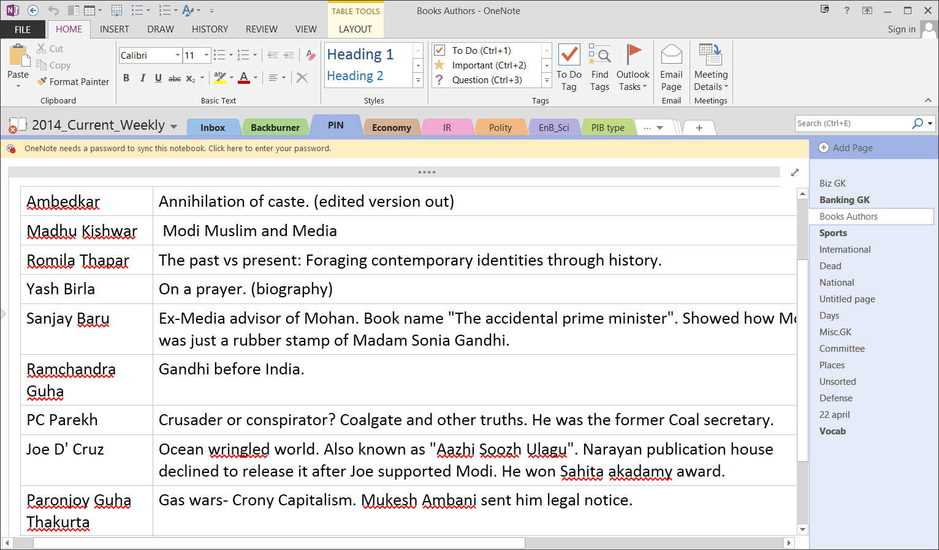
Microsoft Onenote 2013
Cloud sync.

Slide 21
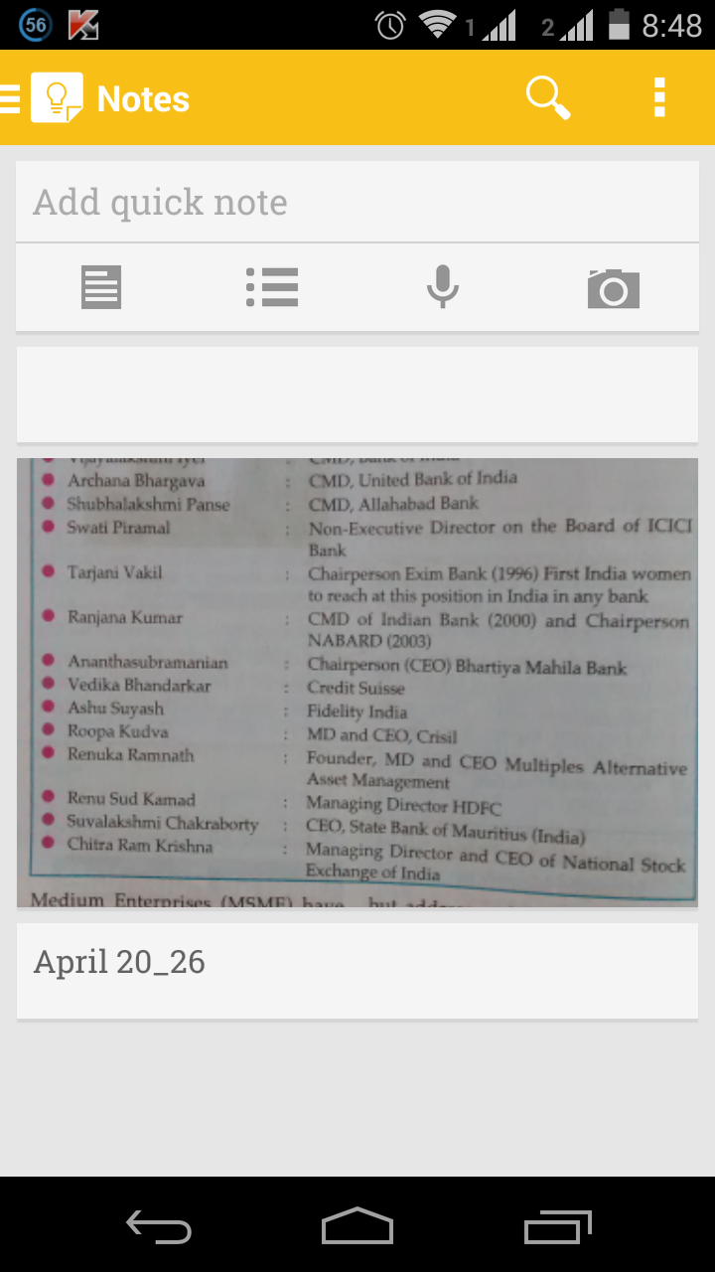
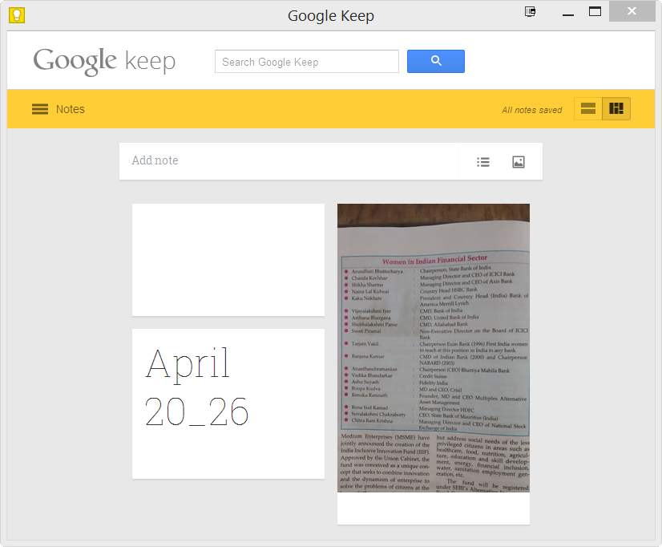
Google Keep

Slide 22
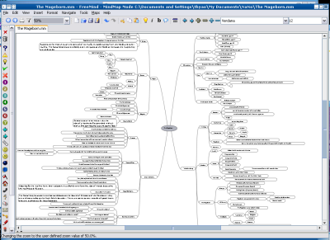
Freemind
Mindjet Mindmanager

Slide 23
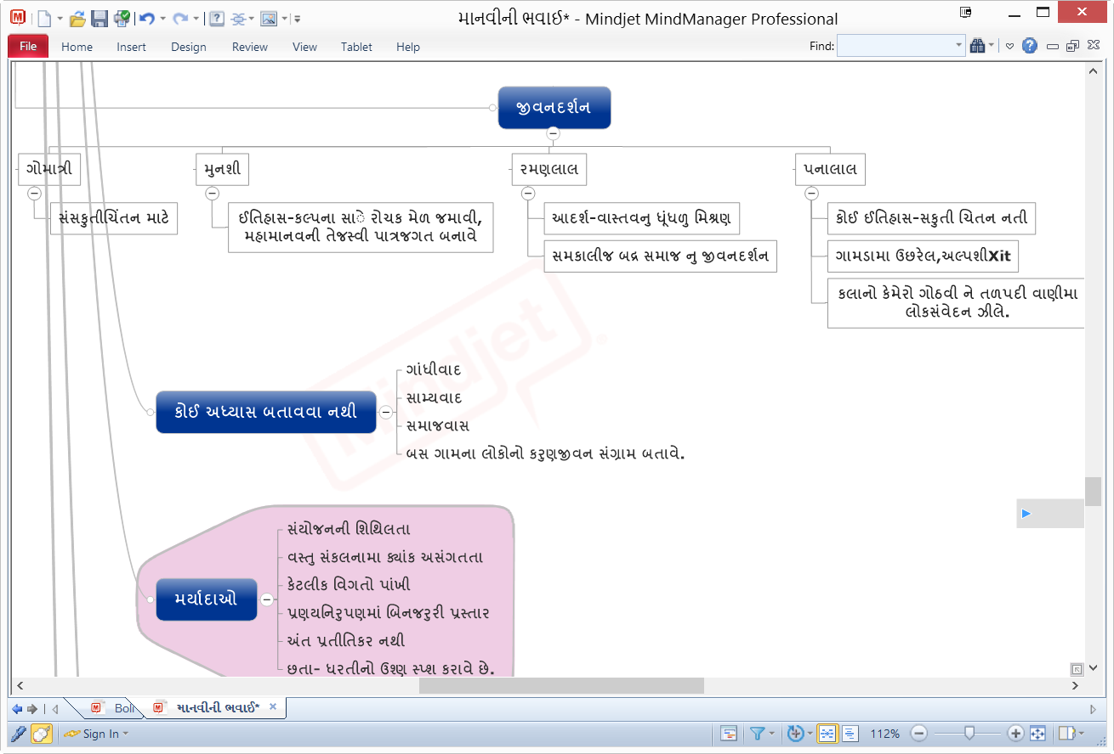

Slide 24
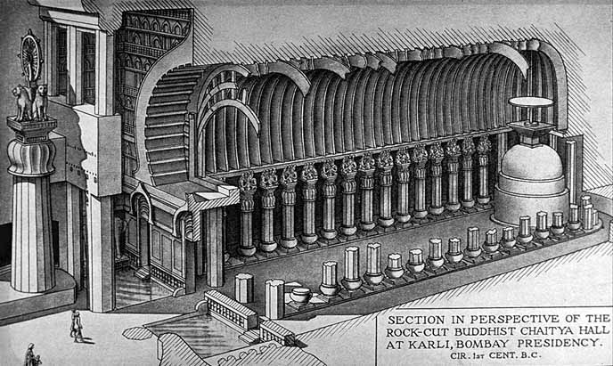
Only 2 caves have such lion pillars in front: Karle & Kanheri
Largest Chaitya-griha
in India
Stupa: Cylindrical Drum shaped
Notes:
Roman Saini

Slide 25
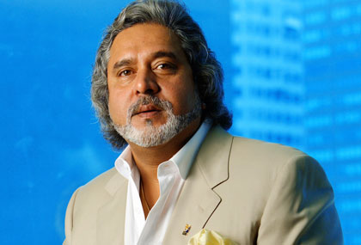
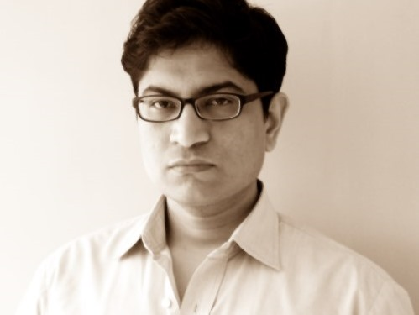

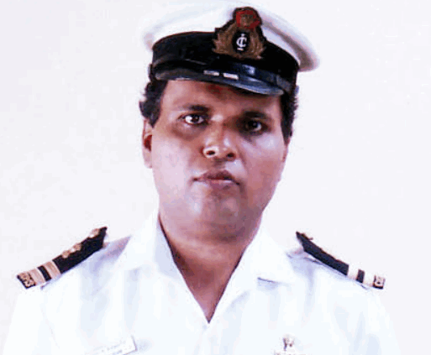


Tax collection 2013
Corp.
IT
Excise
Custom
Service
Wealth

Slide 26
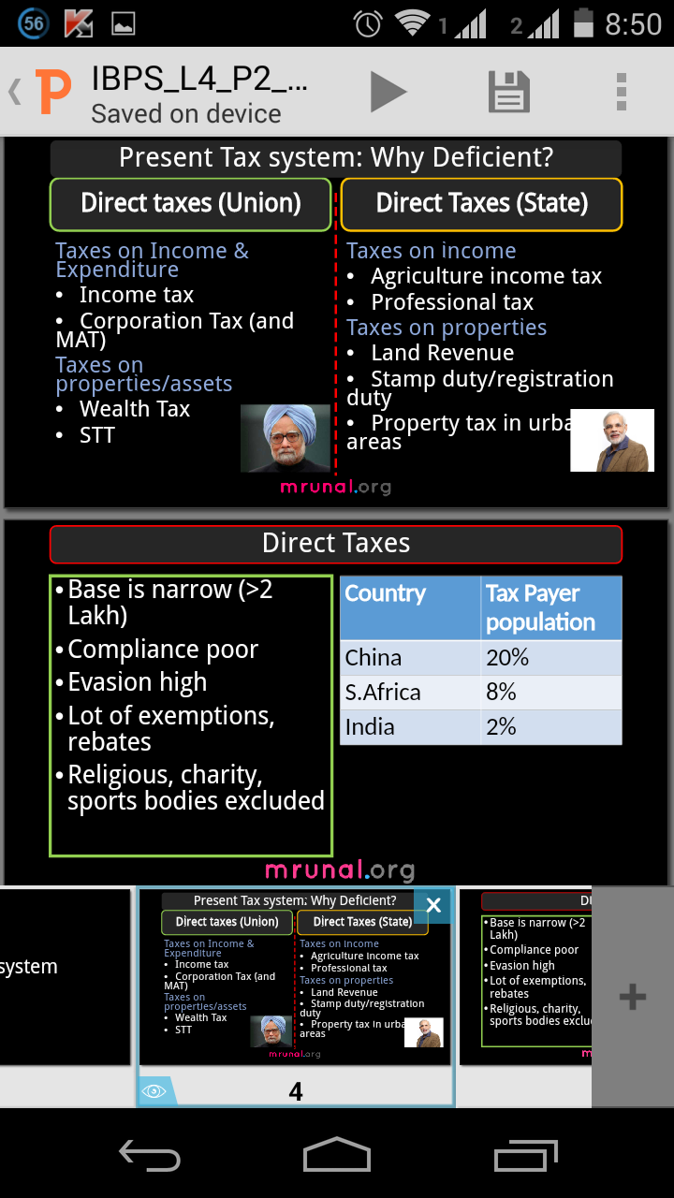
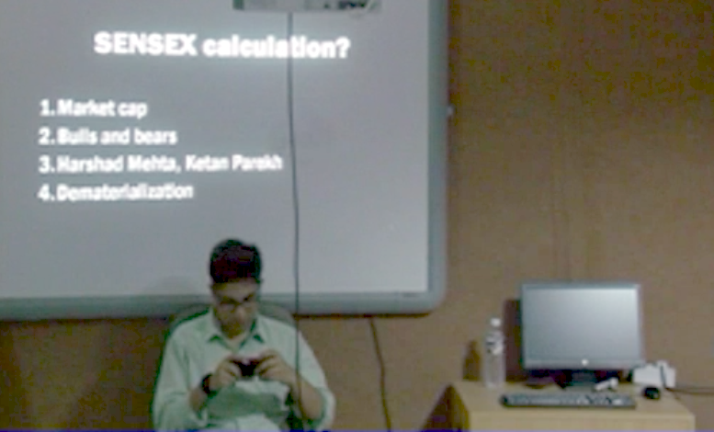
Android: Quick Office

Slide 27
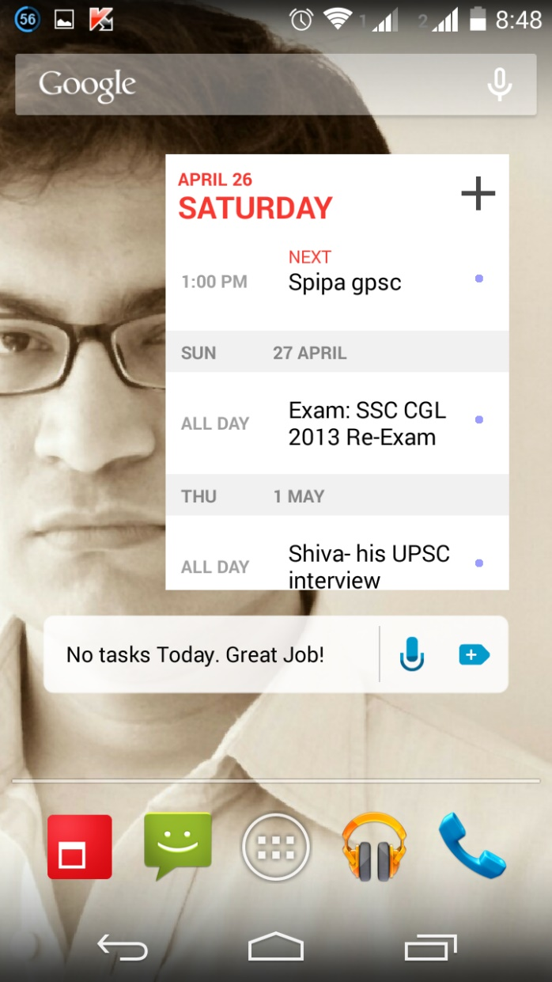
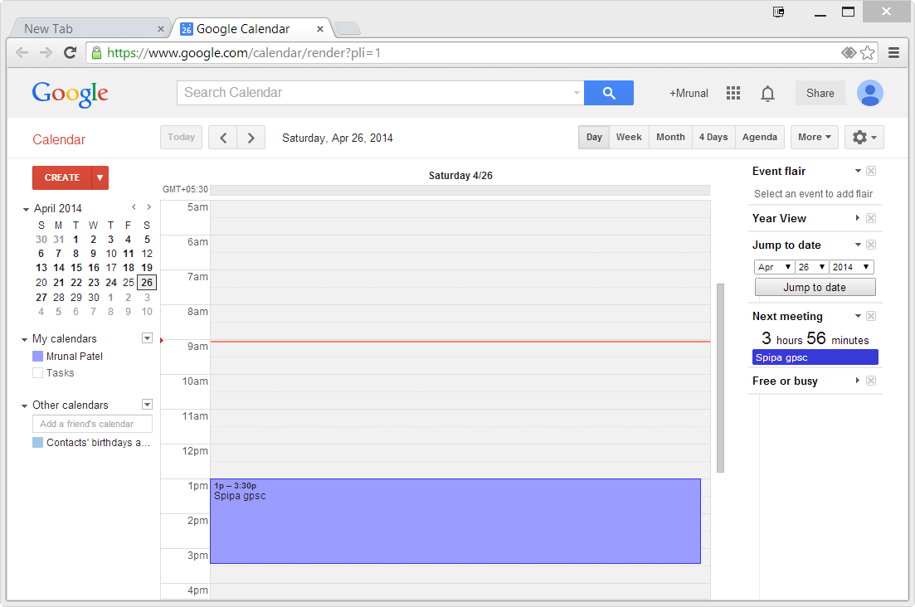
Android: “Cal”
Deadline, Registration id
Notes:
Always preserve question papers and halltickets

Slide 28
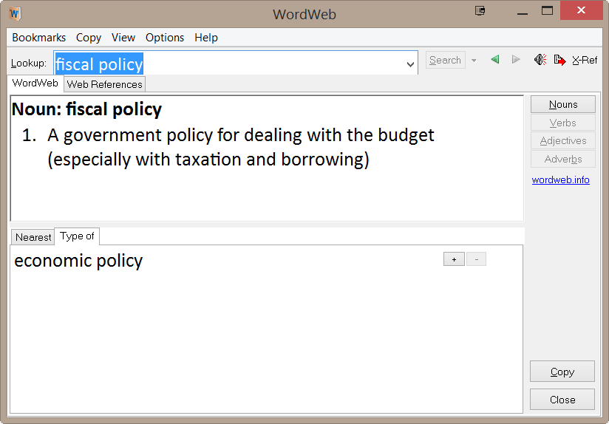
Wordweb (Software)
Pronunciation

Slide 29
End part
Why failures?
Backups?

Slide 30

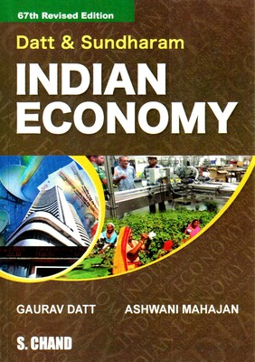
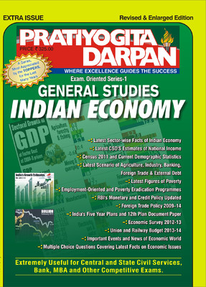
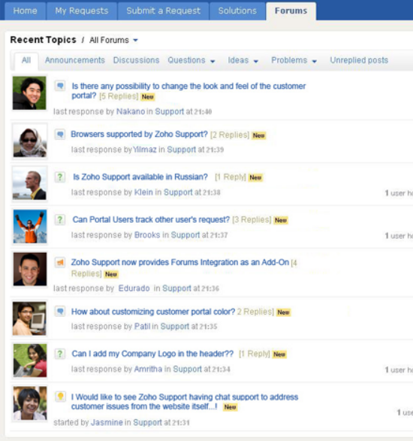
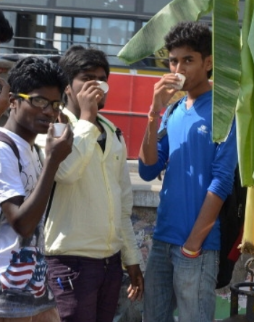
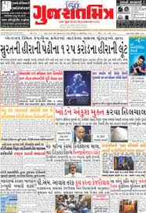
Quality study hours

Slide 31
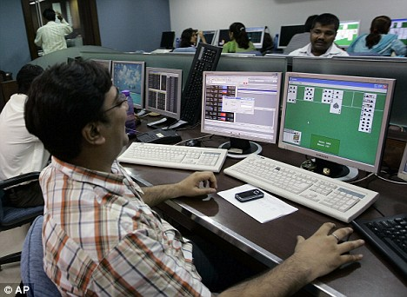


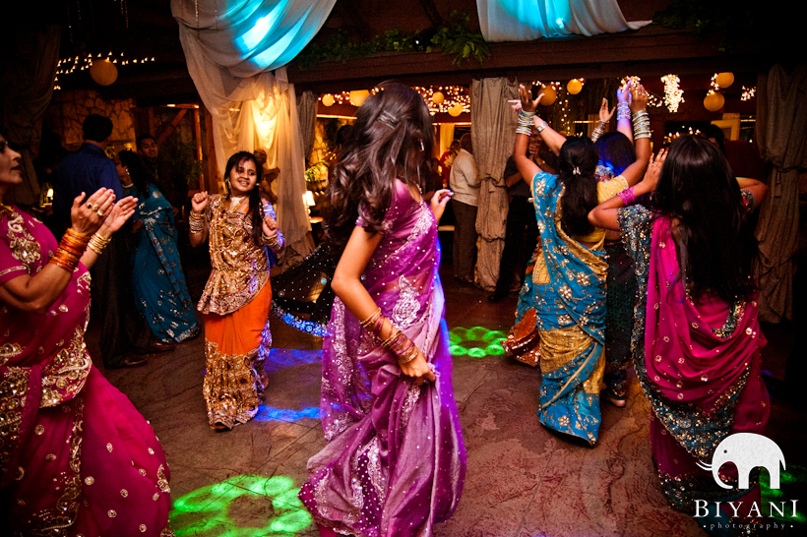

Quality study hours

Slide 32

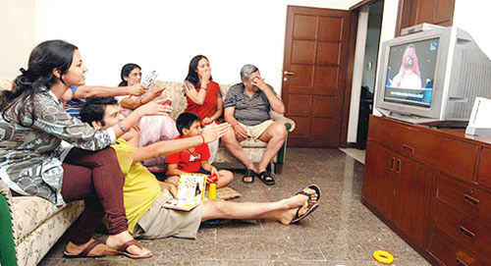
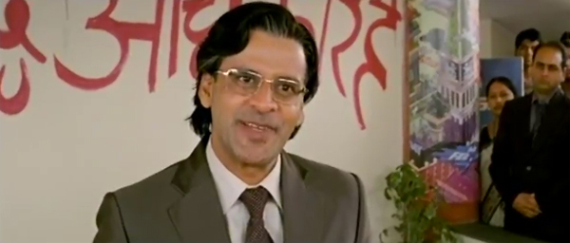
Quality study hours
1. Skip 2. Attempt 3. Mark n Review

Slide 33
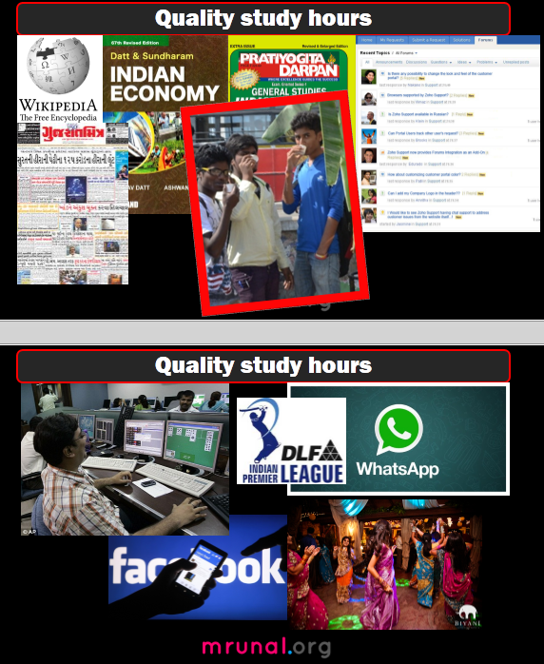

After exam

Slide 34
Advance planning required
SBI 2014 (last date gone)
RBI Grade “B” Officer (GONE): 55% | 50%
IBPS : December (conflict with MAINS?)
SSC (Trigonometry, Algebra)
CAPF: 25 YEARS
CDS 18 Aug (eye sight)
ACIO (“frame”, ~60k bond)
EPFO, ESIC (Labour / HR Degree)
CAT (“Profile Score”)

Slide 35
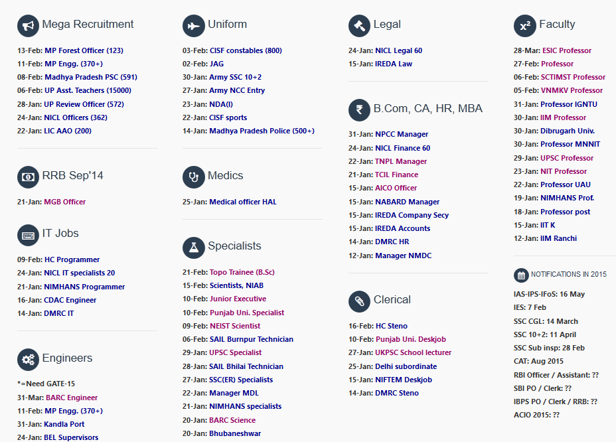
Notification (Age)
OBC vs SEBC
Non-Creamy Layer

Slide 36
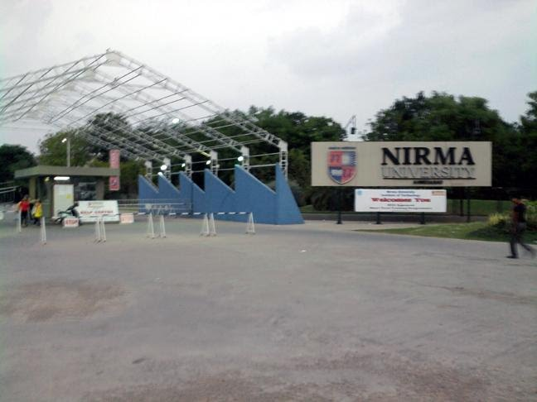
First things first
CCC certificate
IGNOU form
June / July Session (2015)=> 2016 1st year exam
Only Masters OR PG diploma (UGC-NET)

Slide 37
NEXT?
Library Monday to Saturday (9AM-7PM)
Thursday 2PM [Schedule: Email address]
Economy- Sunday

Slide 38
Communication skills
Few mock interviews after mains….X
Dividing the batch into Group of 3-4 students.
Presentation on Current affairs, Group discussion, Debates.

Slide 39
Your Cooperation
Manpower constrains
Attendance sheets
Mock tests- scorekeeping
GD, Current topic list
Hostel vs. city; vehicle-pooling
Facebook page/group
Please don't mark anything in newspapers, magazines and books.

